Slide 1
CS 696: Applied Computer Vision
Instructor: Xiaobai Liu

Slide 2
Today’s Class
Introductions
What is Computer Vision?
Specifics of this course
Questions
Most of Materials are from Brown, Cornell, CMU, and UIUC

Slide 3
What is Computer Vision?
What are examples of computer vision being used in the world?

Slide 4
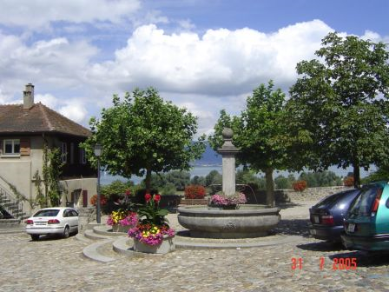
Computer Vision
Make computers understand images and video.
What kind of scene?
Where are the cars?
How far is the building?
…

Slide 5
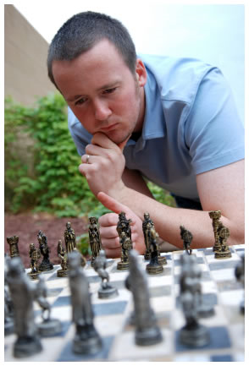
Vision is really hard
Vision is an amazing feat of natural Intelligence
Visual cortex occupies about 50% of Macaque brain
More human brain devoted to vision than anything else
Is that a queen or a bishop?

Slide 6
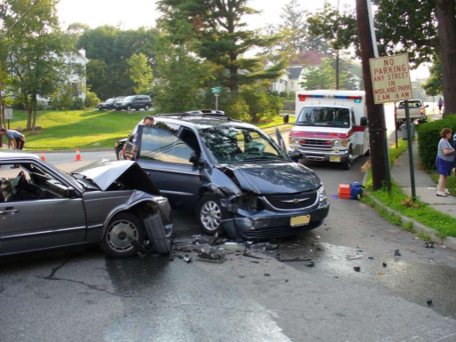
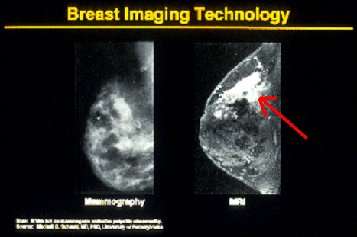
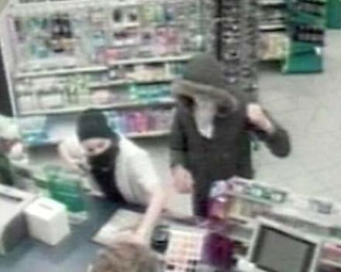
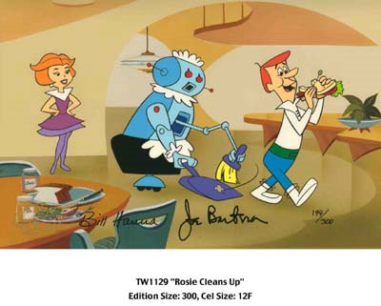
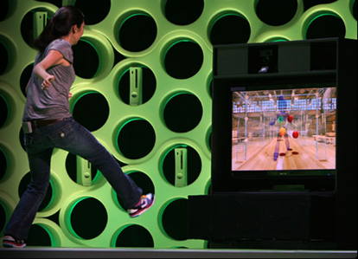
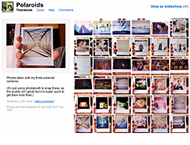
Why computer vision matters
Safety
Health
Security
Comfort
Fun
Access

Slide 7
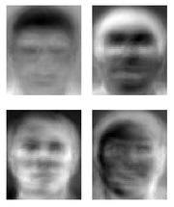
Ridiculously brief history of computer vision
1966: Minsky assigns computer vision as an undergrad summer project
1960’s: interpretation of synthetic worlds
1970’s: some progress on interpreting selected images
1980’s: shift toward geometry and increased mathematical rigor
1990’s: face recognition; statistical analysis in vogue
2000’s: broader recognition; large annotated datasets available; video processing starts
2030’s: robot uprising?
Guzman ‘68
Ohta Kanade ‘78
Turk and Pentland ‘91

Slide 8
How vision is used now
Examples of state-of-the-art
Some of the following slides by Steve Seitz

Slide 9
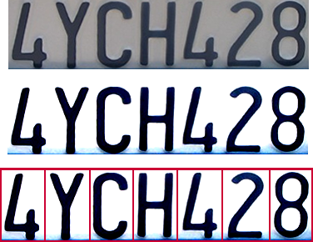

Optical character recognition (OCR)
Technology to convert scanned docs to text
If you have a scanner, it probably came with OCR software
Digit recognition, AT&T labs
http://www.research.att.com/~yann/
License plate readers
http://en.wikipedia.org/wiki/Automatic_number_plate_recognition

Slide 10
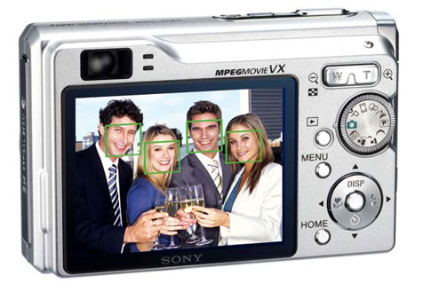
Face detection
Many new digital cameras now detect faces
Canon, Sony, Fuji, …
Notes:
Why would this be useful? Main reason is focus. Also enables “smart” cropping.

Slide 11
Smile detection
Sony Cyber-shot® T70 Digital Still Camera

Slide 12
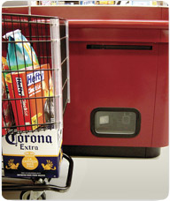
Object recognition (in supermarkets)
LaneHawk by EvolutionRobotics
“A smart camera is flush-mounted in the checkout lane, continuously watching for items. When an item is detected and recognized, the cashier verifies the quantity of items that were found under the basket, and continues to close the transaction. The item can remain under the basket, and with LaneHawk,you are assured to get paid for it… “

Slide 13
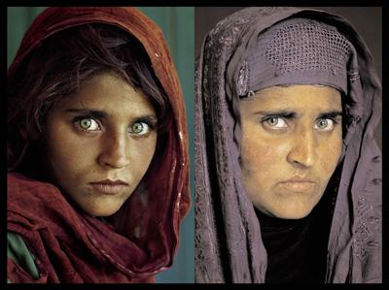
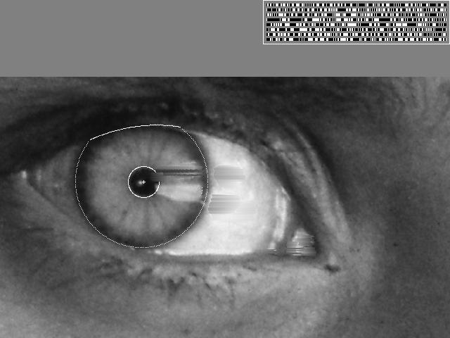
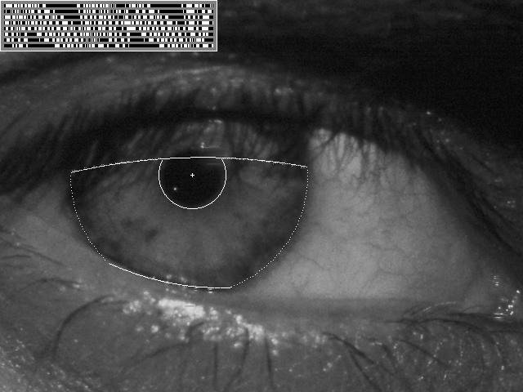
Vision-based biometrics
“How the Afghan Girl was Identified by Her Iris Patterns” Read the story
wikipedia
Notes:
Age 12, Age 30

Slide 14
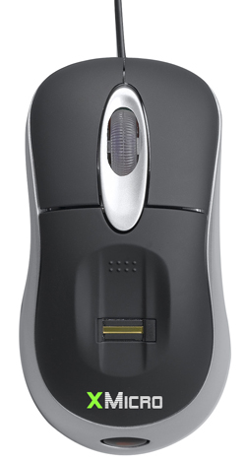
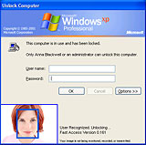
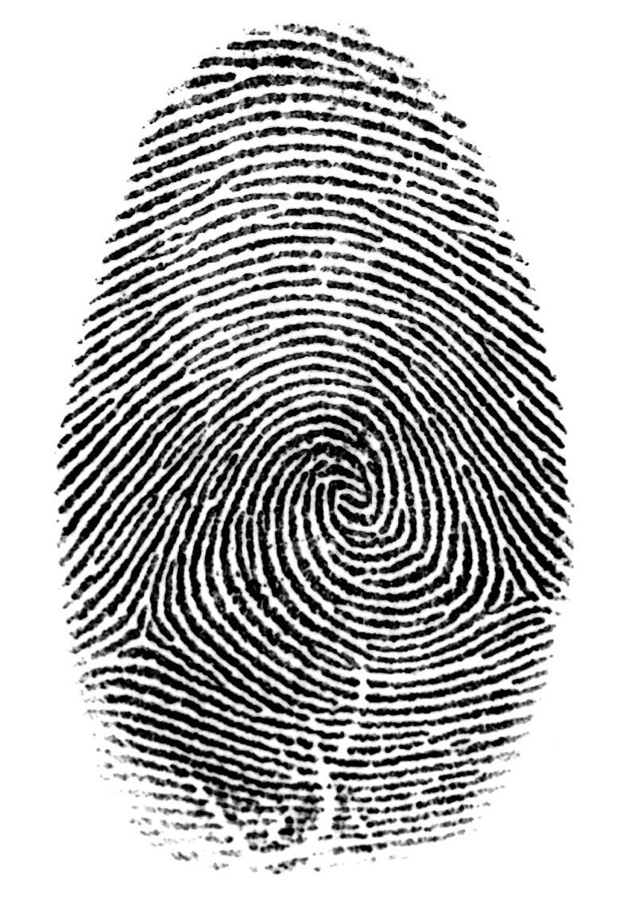

Login without a password…
Fingerprint scanners on many new laptops, other devices
Face recognition systems now beginning to appear more widely http://www.sensiblevision.com/

Slide 15
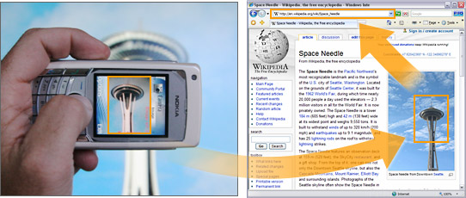
Object recognition (in mobile phones)
Point & Find, Nokia
Google Goggles

Slide 16
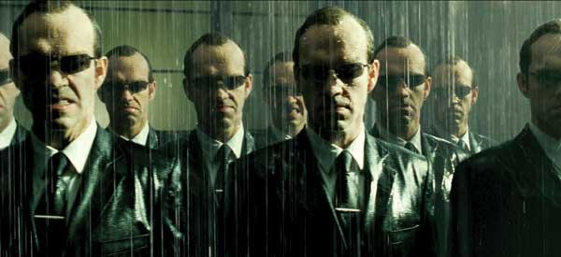
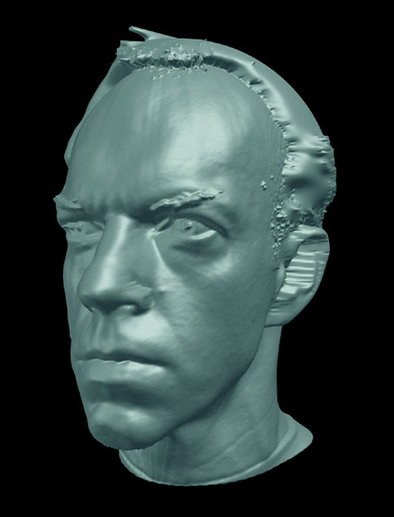
Special effects: shape capture
The Matrix movies, ESC Entertainment, XYZRGB, NRC

Slide 17
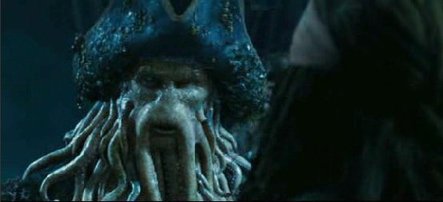
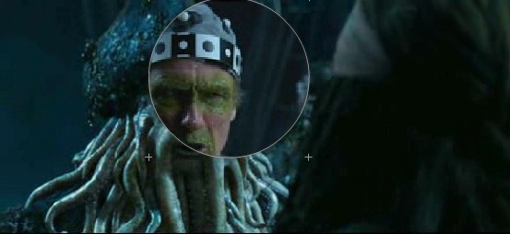
Special effects: motion capture
Pirates of the Carribean, Industrial Light and Magic

Slide 18
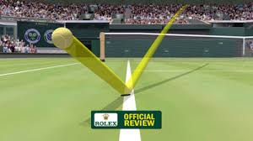
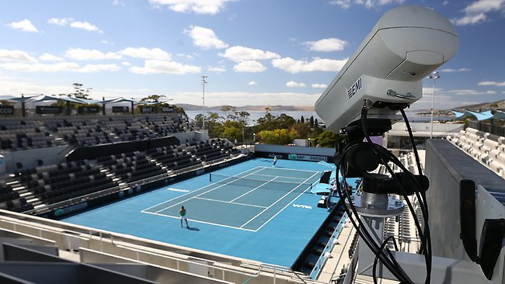
Sports: tennis
Hawk-eye System

Slide 19
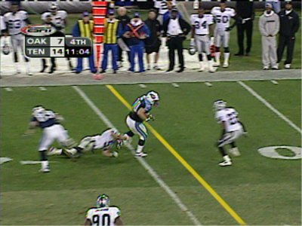
Sports: football
Sportvision first down line
Nice explanation on www.howstuffworks.com
http://www.sportvision.com/video.html

Slide 20
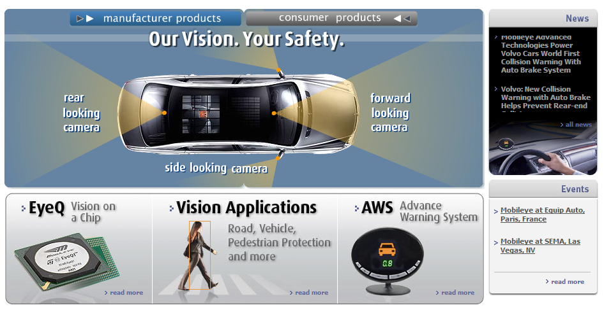
Smart cars
Slide content courtesy of Amnon Shashua
Mobileye
Vision systems currently in high-end BMW, GM, Volvo models
By 2010: 70% of car manufacturers.

Slide 21
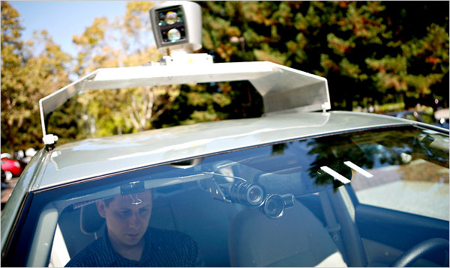
Google cars
Oct 9, 2010. "Google Cars Drive Themselves, in Traffic". The New York Times. John Markoff
June 24, 2011. "Nevada state law paves the way for driverless cars". Financial Post. Christine Dobby
Aug 9, 2011, "Human error blamed after Google's driverless car sparks five-vehicle crash". The Star (Toronto)

Slide 22
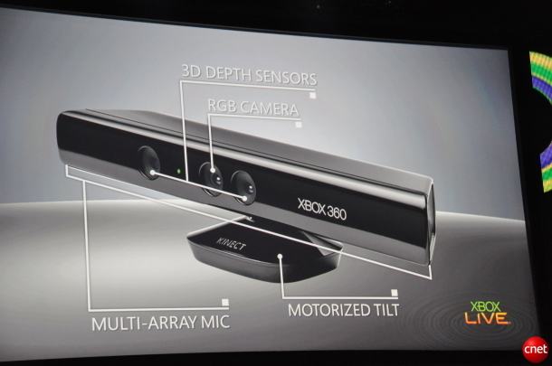
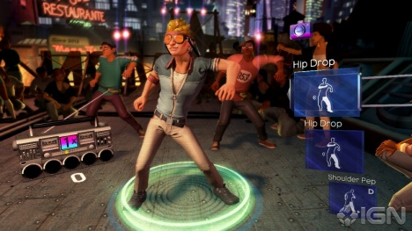
Interactive Games: Kinect
Object Recognition: http://www.youtube.com/watch?feature=iv&v=fQ59dXOo63o
Mario: http://www.youtube.com/watch?v=8CTJL5lUjHg
3D: http://www.youtube.com/watch?v=7QrnwoO1-8A
Robot: http://www.youtube.com/watch?v=w8BmgtMKFbY

Slide 23
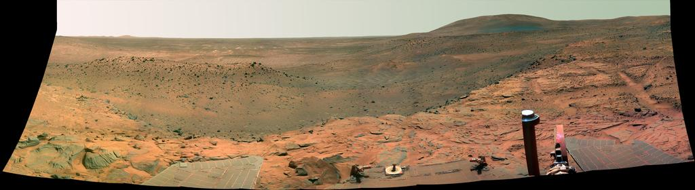
Vision in space
NASA'S Mars Exploration Rover Spirit captured this westward view from atop a low plateau where Spirit spent the closing months of 2007.
Vision systems (JPL) used for several tasks
Panorama stitching
3D terrain modeling
Obstacle detection, position tracking
For more, read “Computer Vision on Mars” by Matthies et al.

Slide 24
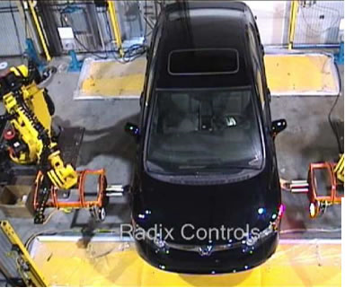
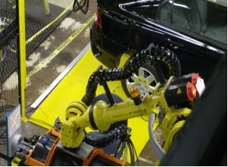
Industrial robots
Vision-guided robots position nut runners on wheels

Slide 25

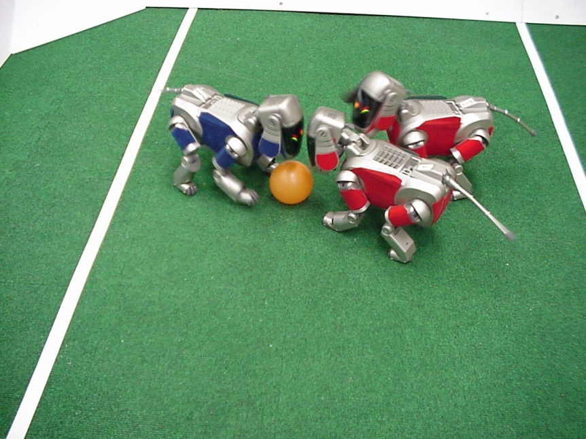
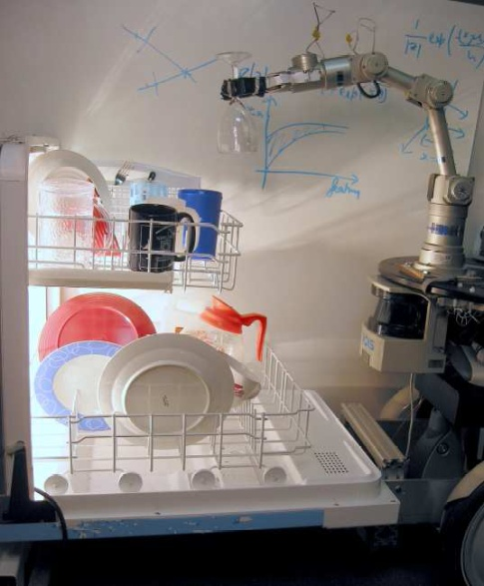
Mobile robots
NASA’s Mars Spirit Rover
http://en.wikipedia.org/wiki/Spirit_rover
http://www.robocup.org/
Saxena et al. 2008
STAIR at Stanford

Slide 26
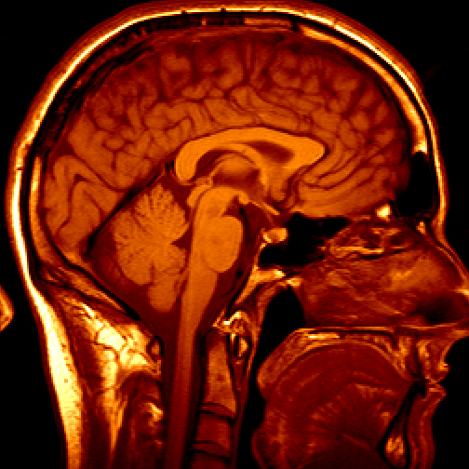
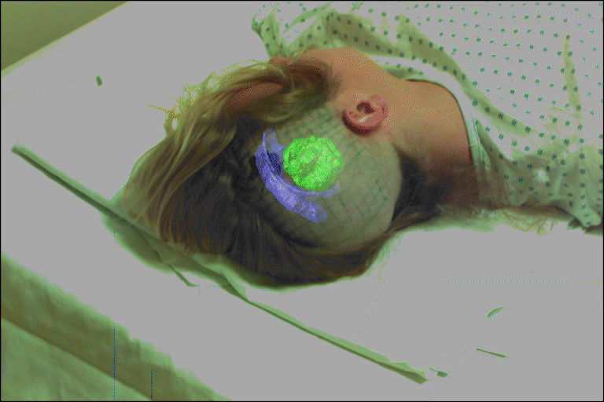
Medical imaging
3D imaging
MRI, CT
Image guided surgery
Grimson et al., MIT

Slide 27
Computer Vision and Nearby Fields
Computer Vision
Images to Models
Computer Graphics
Models to Images
Comp. Photography (image processing)
Images to Images

Slide 28
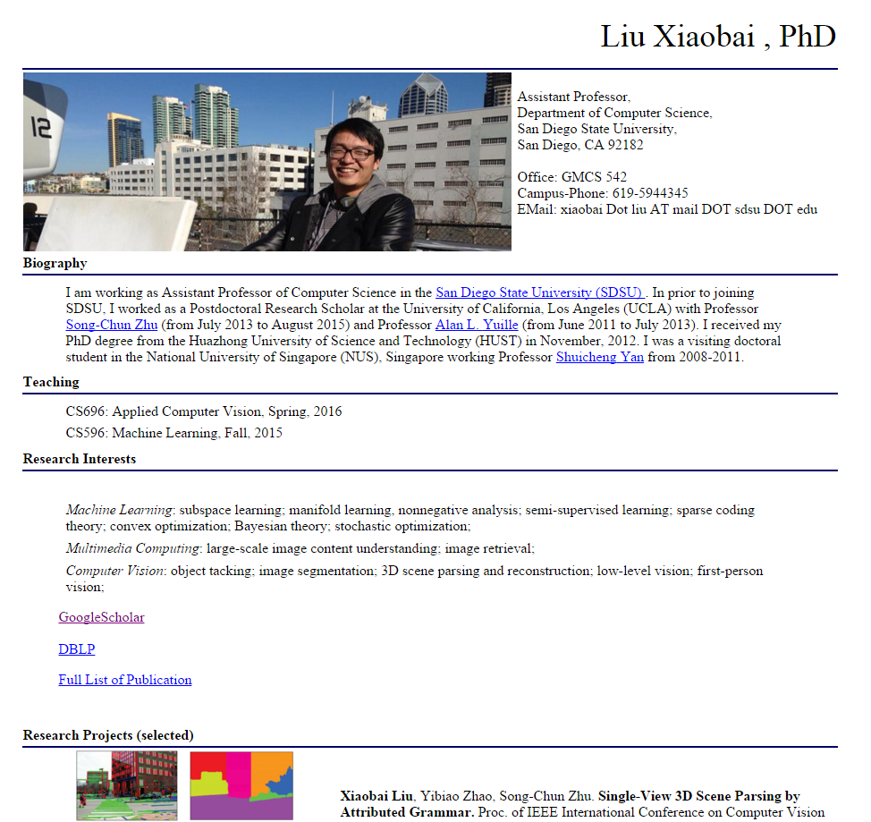
Computer Vision at SDSU
http://cv.sdsu.edu

Slide 29
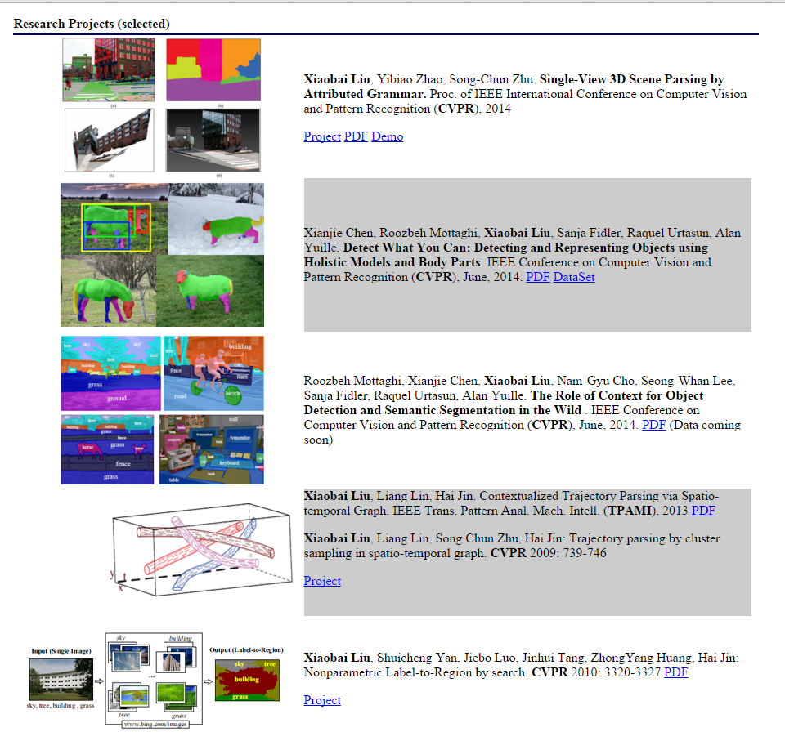

Slide 30
Course Information
Office hours
Syllabus
Grading
Topics
Reading
Course Project and Assignments

Slide 31
Office hours
Instructor: Xiaobai (byran) Liu
GMCS 531
11:00-11:45am, Tuesday/Thursday
Appointment by email: xiaobai.liu@sdsu.edu

Slide 32
Course Syllabus (tentative)
Will be available in Blackboard

Slide 33
Grading
(50%) Five homework assignments (HA): each is mixture of programming and quiz.
10% HA1: matlab programming
10% HA2
10% HA3
10% HA4
10% HA5
(25) Mid-term Exam
(25%) class project
(5%) Class attendance and extra credits

Slide 34
Scope of CS 696
Computer Vision
Robotics
Machine Learning
Human Computer Interaction
Image formatting Feature Matching Recognition
Segmentation
Tracking
Graphics
Medical Imaging
Computational Photography
Neuroscience
Optics

Slide 35
Course Topics
Interpreting Intensities
What determines the brightness and color of a pixel?
How can we use image filters to extract meaningful information from the image?
Correspondence and Alignment
How to detect edges and interest points
How can we find corresponding points in objects or scenes?
How can we estimate the transformation between them?
Multiple Views and Motions
How to measure depth using stereo system?
How to reconstruct scenes from images?
How to track features over time or between views?
Machine learning Tools
How can machine learning methods help computer vision tasks?
Categorization and Object Recognition
How can we represent images and categorize them?
How can we recognize categories of objects?
Grouping and Segmentation
How can we group pixels into meaningful regions?
Object Tracking
How can we track objects of interest in video sequence?
Advanced Topics
Modern object detections and boundary detections, Deep Learning in Computer Vision

Slide 36
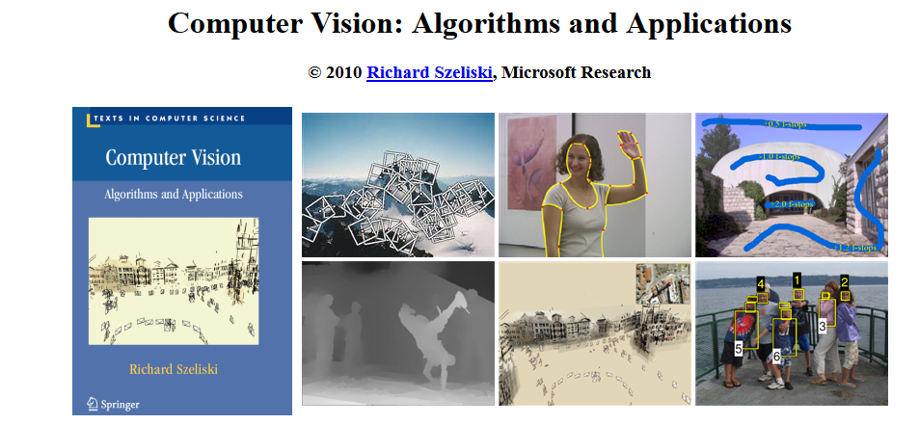
Textbook
http://szeliski.org/Book/ (Free)

Slide 37
Prerequisites
Linear algebra, basic calculus, and probability
Experience with image processing or Matlab will help but is not necessary

Slide 38
Homework Assignments
Each assignment is a mixture of
Problem sets
Programming
Quiz
Turn in all homework assignments through blackboard.
Late Submission Policy: will lose 10% each day for late submission. Three 'late day' for the whole semester.

Slide 39
Programming Language
Matlab + Python
All exemplar codes will be provided for Matlab only. Students may try to implement the same codes in other languages which is in general way more difficult and time-consuming.
Python might be used for teaching some advanced topics.
This course however doesn't cover the programming skills in matlab or python
The first homework assignment is designed to guide you through the necessary matlab skills

Slide 40
Matlab Installment
Free for SDSU students
http://www-rohan.sdsu.edu/~download/matlab.html

Slide 41
Next Class
Topics: Geometry and camera models
Reading: Szeliski 2.1, especially 2.1.5

